Slide 1


BRAIN TUMOR
DETECTION USING CNN
Presented by
Akshil Anilkumar Mundakatil
017416321
ISE 244

Slide 2

OVERVIEW
Problem Definition
Need for a new approach
Project Objectives
Project architecture and flow
Results
Discussion
Evaluation and Reflection
Conclusion

Slide 3

PROBLEM DEFINITION
A brain tumor is a growth of abnormal cells in the brain. Some brain tumors can be cancerous or can become cancerous. Early detection of brain tumors is very essential as it can become very fatal if left unattended.
Benign | Malignant
Menignoma, Pitutary | Glioma

Slide 4

NEED FOR A NEW APPROACH
Insufficient data.
The model is only able to predict whether a tumor is present or not.
The model does not comprise images from all sides of the brain.
There is no discussion regarding a stable platform to deploy the model.

Slide 5

PROJECT OBJECTIVES
Dataset Selection
Data Augmentation / Pre-processing
Model Implementation
Performance Evaluation
Deployment.

Slide 6

PROJECT ARCHITECTURE AND FLOW
Dataset Overview
Data Pre-processing and Augmentation
Model Implementation
Result analysis
Model Selection

Slide 7
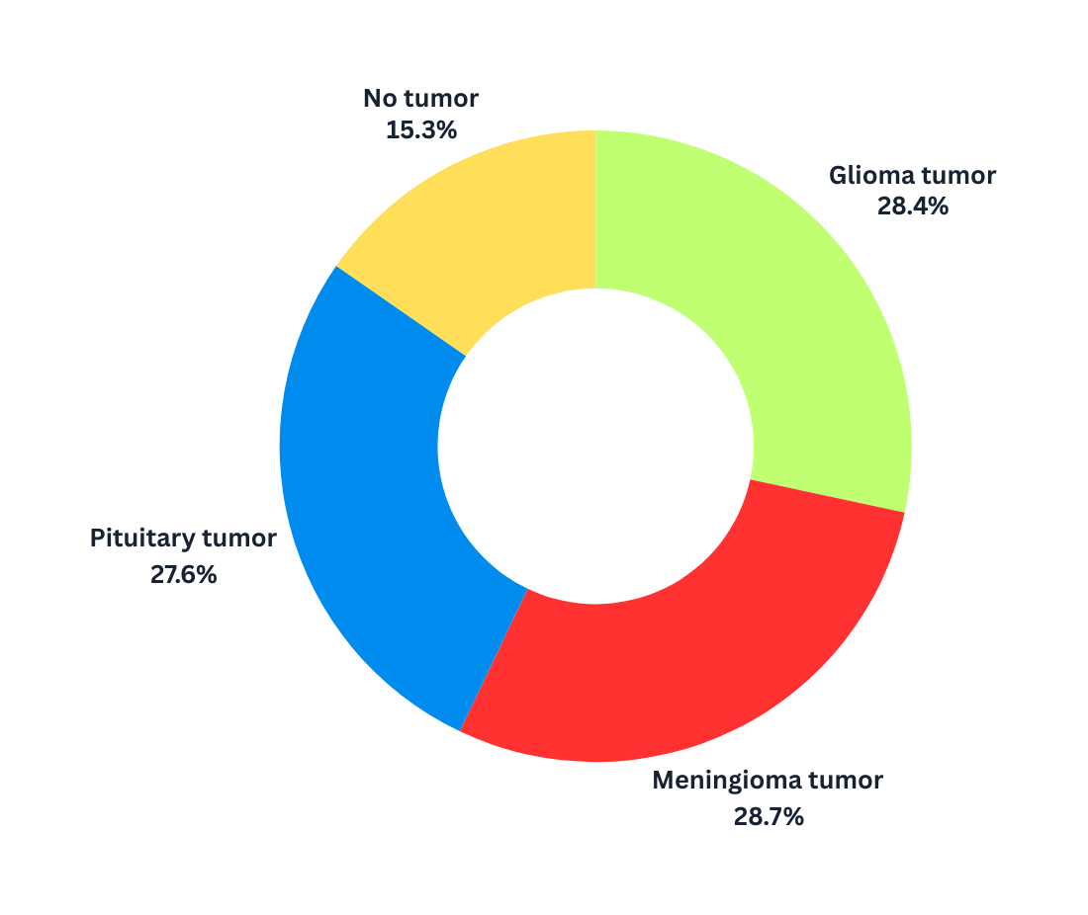
No Tumor
Glioma Tumor
Meningioma Tumor
Pituitary Tumor

Slide 8
MRI DATASET
IMAGE PREPROCESSING
CNN - TRANSFER LEARNING
TUMOR CLASSIFICATION
GLIOMA
NO TUMOR
MENINGIOMA
PITUITARY

Slide 9

CNN Models used
EfficientNet
ResNet
DenseNet
MobileNet
Xception
Inception

Slide 10

RESULTS
Model Performance
Confusion Matrix Analysis
Evaluation Parameter Analysis

Slide 11
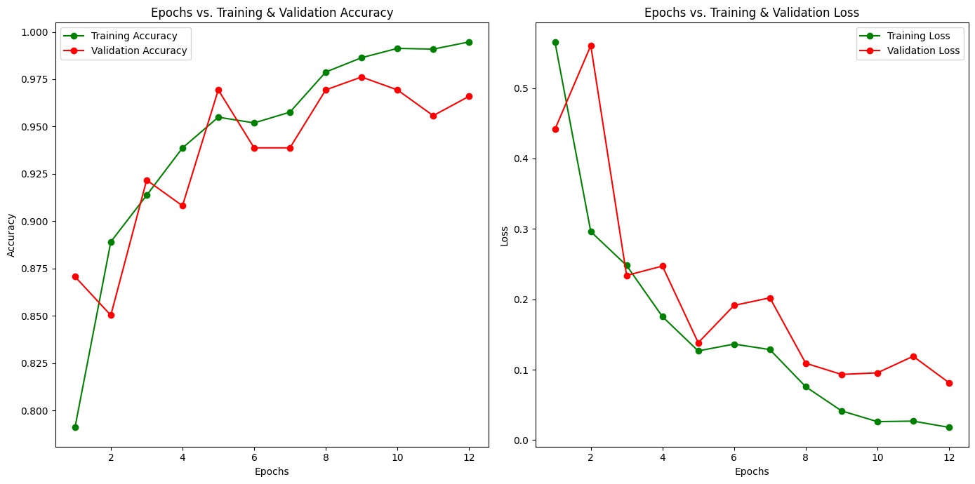
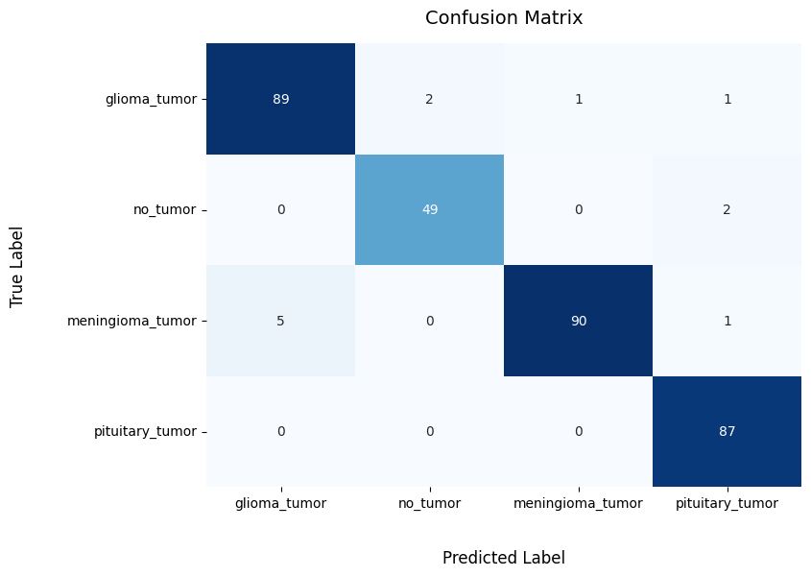
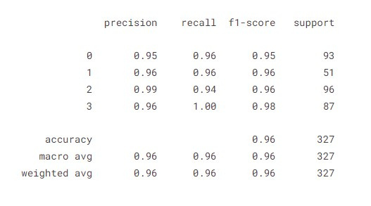
Model : EfficientNetV2

Slide 12
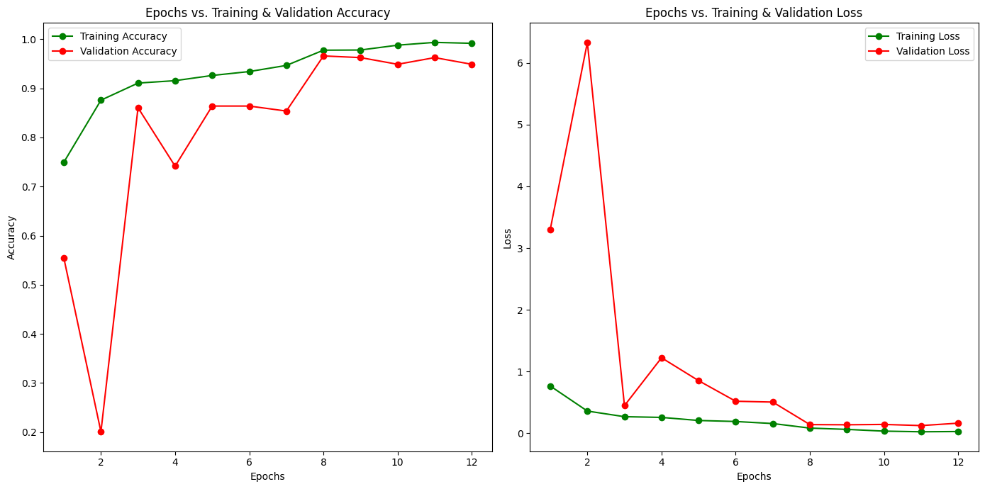

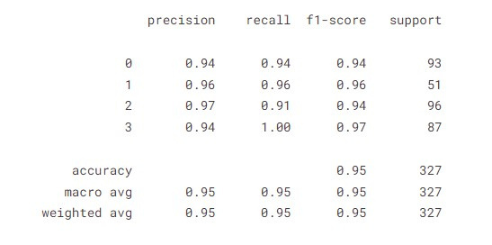
Model : DenseNet

Slide 13
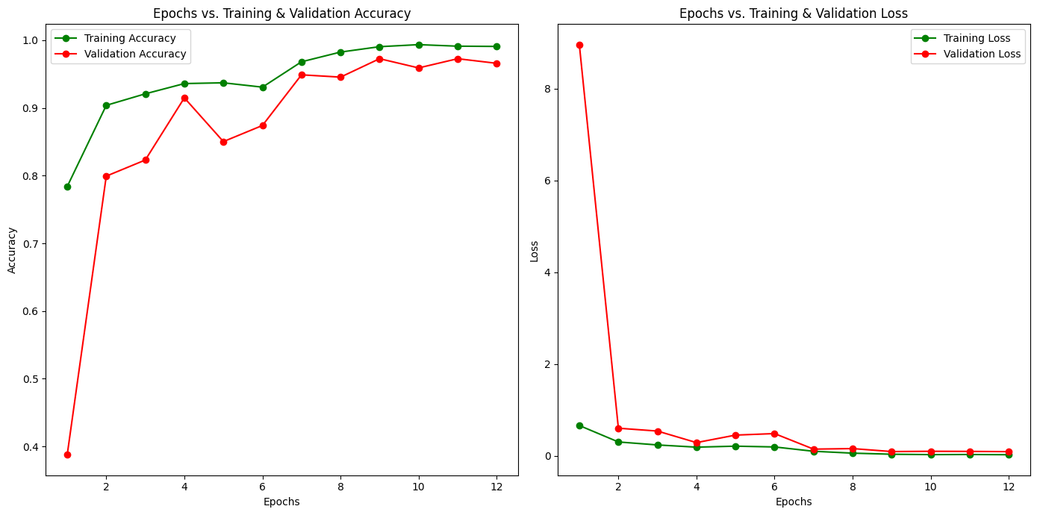

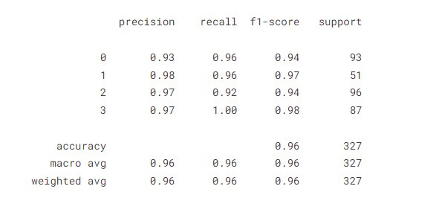
Model : Inception

Slide 14

DISCUSSION
Model comparison
Model selection

Slide 15
ACCURACY | PRECISION | F1 | RECALL
96% | 96% | 96% | 96%
95% | 95% | 95% | 95%
94% | 95% | 94% | 94%
69% | 84% | 70% | 69%
95% | 95% | 95% | 95%
96% | 96% | 96% | 96%
EFFICIENTNET
DENSENET
RESNET
MOBILENET
XCEPTION
INCEPTION

Slide 16
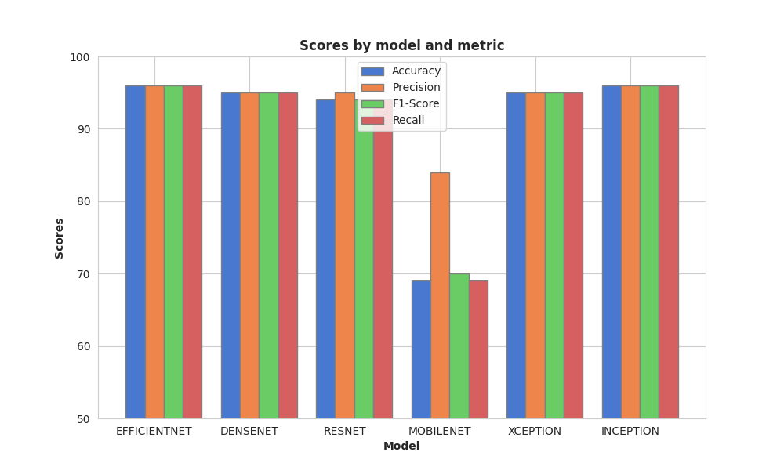

Slide 17

EVALUATION AND REFLECTION
UML and Block Diagrams
Assumptions and solutions

Slide 18


Brain MRI Tumor Detection
Log in to the website
Patient / Doctor
Upload Image
Model
Results

Slide 19
MRI Brain Tumor Detection Platform
User Interface Backend API Admin
User Interface
Upload MRI Image View Prediction Interpret Results
Admin
Manage Users Monitor Activity
Backend API
Receive Image Data Process Requests

Slide 20
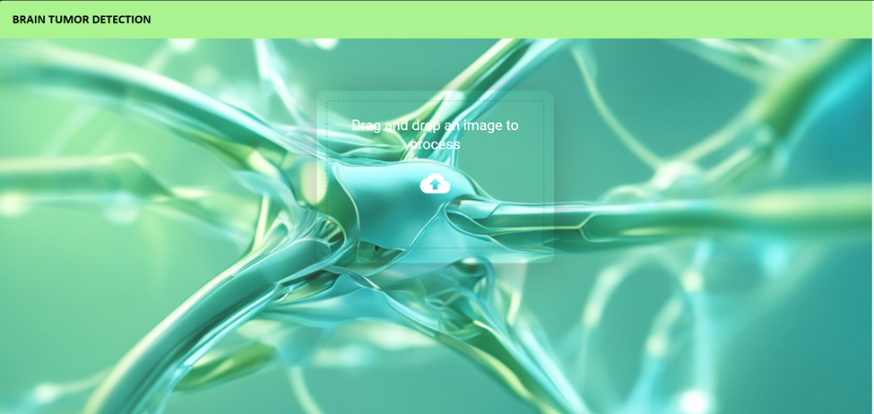

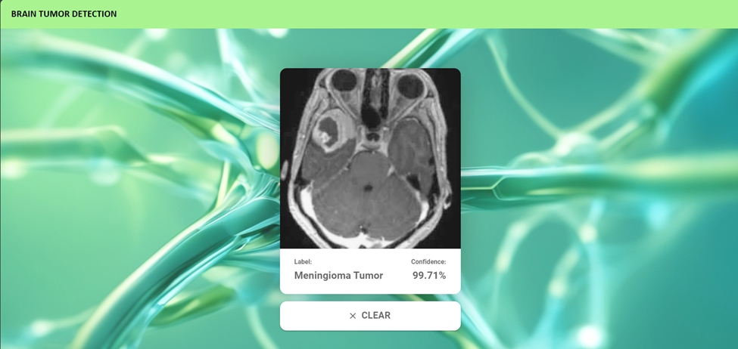
Web platform Using FastAPI

Slide 21
ASSUMPTION
SOLUTIONS
Old model’s 3d inability
Lack of data volume
Tumor type detection not possible
Model Accuracy on CNN
No platform to deploy model
Tumor detection from all sides
12 times more data
Accurate tumor type detection
Transfer Learning
Deployed a platform for model deployment

Slide 22

CONCLUSION
Project Achievements
Future Directions

Slide 23
Thank
You

Slide 24
REFERENCES
[1] MRI brain tumor detection and classification using parallel deep convolutional neural networks:
Takowa Rahman, Md Saiful Islam, Measurement: Sensors, Volume 26, 2023, 100694, ISSN
2665-9174
https://doi.org/10.1016/j.measen.2023.100694.
(https://www.sciencedirect.com/science/article/pii/S2665917423000302)
[2] Enhancement of brain tumor classification from MRI images using multi-path convolutional neural network with SVM classifier:
Sahar Khoramipour, Mojtaba Gandomkar, Mohsen Shakiba,
Biomedical Signal Processing and Control, Volume 93, 2024, 106117, ISSN 1746-8094,
https://doi.org/10.1016/j.bspc.2024.106117.
(https://www.sciencedirect.com/science/article/pii/S1746809424001757)
[3] Dermatological infrared thermal imaging with human-machine interaction image diagnostics interface using DenseNet:
Xing She, Honglei Lu, Qian Liu, Peng Xie, Qian Xia, Journal of Radiation Research and
Applied Sciences, Volume 17, Issue 1, 2024, 100826, ISSN 1687-8507,
https://doi.org/10.1016/j.jrras.2024.100826.
(https://www.sciencedirect.com/science/article/pii/S1687850724000104)
[4] Crossover smell agent optimized multilayer perceptron for precise brain tumor classification on MRI images:
Muthuvel Arumugam, Arunprasath Thiyagarajan, Lakshmi Adhi, Shyamala Alagar,
https://doi.org/10.1016/j.eswa.2023.121453.
(https://www.sciencedirect.com/science/article/pii/S0957417423019553)

Slide 25
REFERENCES
[5] https://www.hopkinsmedicine.org/health/conditions-and-diseases/brain-tumor/brain-tumor-types
[6] Dataset:
https://www.kaggle.com/datasets/navoneel/brain-mri-images-for-brain-tumor-detection
[7] New Dataset:
https://www.kaggle.com/datasets/sartajbhuvaji/brain-tumor-classification-mri
[8] Title= EfficientNetV2: Smaller Models and Faster Training, author = Mingxing Tan and Quoc V. Le, year = 2021
https://arxiv.org/abs/2104.00298

